Slide 1
Lec 1: IPv4 Addressing
Introduction to Networks
Notes:
Cisco Networking Academy program
Introduction to Networks
Chapter 8: IP Addressing

Slide 2
Topics
8.0 Introduction
8.1 IPv4 Network Addresses
8.2 IPv6 Network Addresses
8.3 Connectivity Verification
8.4 Summary
Notes:
Chapter 8 Sections

Slide 3
Objectives
  ** Chapter 8 in CCNA R&S: Introduction to Networks 1
Upon completion of this chapter, you will be able to:
Describe the structure of an IPv4 address.
Describe the purpose of the subnet mask.
Compare the characteristics and uses of the unicast, broadcast, and multicast IPv4 addresses.
Compare the use of public address space and private address space.
Describe the role of ICMP in an IP network. (Include IPv4 and IPv6.)
Use ping and traceroute utilities to test network connectivity.
Notes:
Chapter 8 Objectives

Slide 4
8.1 IPv4 Network Addresses
Notes:
8.1 IPv4 Network Addresses

Slide 5
IPv4 Address Structure
Represented in Dotted Decimal Format
network portion
host portion
192 168 10 1
11000000 . 10101000 . 00001010 . 00000001
* assuming a network mask of 255.255.255.0
How many bits in an IPv4 address? ________
How many octets are there? ________
How many bits are there in an octet? ________
What is the decimal range of each octet? ________
an octet
Notes:
8.1.1.1 Binary Notation

Slide 6
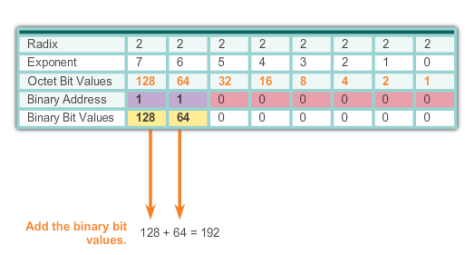
IPv4 Address Structure
Binary Number System
The Binary number system (or Base 2)
  only two digits: 0 and 1
  let’s examine 1 octet in an IPv4 address, 1 1 0 0 0 0 0 0:-
Notes:
8.1.1.2 Binary Number System

Slide 7


IPv4 Address Structure
Converting a Binary Address to Decimal
Practice
176
So 10110000 = _____________
255
So 11111111 = _____________
Notes:
8.1.1.3 Converting a Binary Address to Decimal

Slide 8
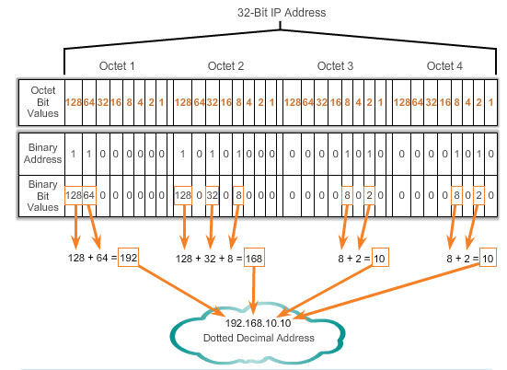
IPv4 Address Structure
Converting a Binary Address to Decimal
Notes:
Section 8.1.1.3 & 8.1.1.4 Converting a Binary Address to Decimal

Slide 9
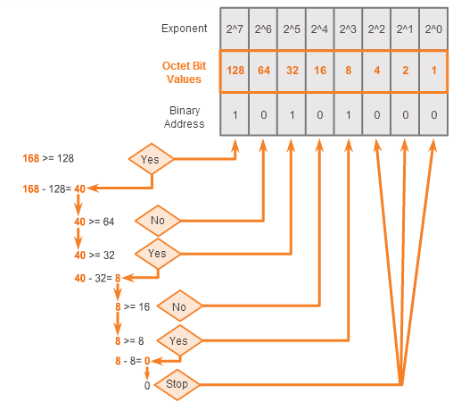
IPv4 Address Structure
Converting from Decimal to Binary
Converting decimal to binary is a series of steps starting from the leftmost bit of the octet
168 = ? In binary
Notes:
8.1.1.5 Converting from Decimal to Binary

Slide 10
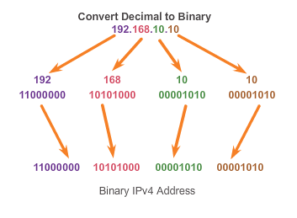
IPv4 Address Structure
Converting from Decimal to Binary (Cont.)
Notes:
8.1.1.6 Converting from Decimal to Binary (Cont.)

Slide 11
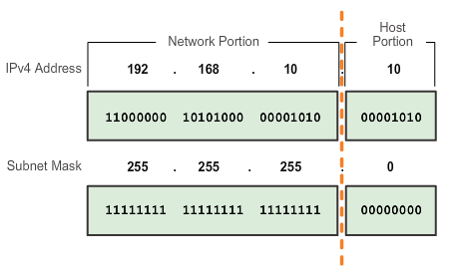
IPv4 Subnet Mask
Network Portion and Host Portion of an IPv4 Address
To define the network and host portion of an address, a separate 32-bit pattern called a subnet mask is used.
The subnet mask does not actually contain the network or host portion of an IPv4 address, it just tells you where to look for these portions in a given IPv4 address
Subnet mask appears in binary as a series of 1s followed by a series of 0s.
The network divide (dash line) for the IP address is where the series of 1s meet the 0s in the subnet mask.
Notes:
8.1.2.1 Network Portion and Host Portion of an IPv4 Address

Slide 12
IPv4 Subnet Mask
Network Portion and Host Portion of an IPv4 Address
Example 1: IPv4 address: 10.20.30.40
Subnet mask: 255.255.0.0 (or /16)
Network portion
Host portion
IPv4 address: | 10. | 20. | 30. | 40
(in binary): | 00001010. | 00010100. | 00011110. | 00101000
Subnet mask: | 255. | 255. | 0. | 0
(in binary): | 11111111. | 11111111. | 00000000. | 00000000
Representing the subnet mask as a subnet prefix:
Subnet mask is in dotted decimal format
It can also be represented in a prefix format such as /16 as in this example above by counting the number of 1s in the binary form of the subnet mask
Notes:
8.1.2.1 Network Portion and Host Portion of an IPv4 Address

Slide 13
IPv4 Subnet Mask
Network Portion and Host Portion of an IPv4 Address
Example 2: IPv4 address: 10.20.30.40
Subnet mask: 255.255.240.0 (or /20)
Network portion
Host portion
IPv4 address: | 10. | 20. | 30. | 40
(in binary): | 00001010. | 00010100. | 0001 1110. | 00101000
Subnet mask: | 255. | 255. | 240. | 0
(in binary): | 11111111. | 11111111. | 1111 0000. | 00000000
Notes:
8.1.2.1 Network Portion and Host Portion of an IPv4 Address

Slide 14
IPv4 Subnet Mask
Network Portion and Host Portion of an IPv4 Address
Example 3: IPv4 address: 10.20.30.40 /24
Subnet mask: _______________
255.255.255.0
Network portion
Host portion
IPv4 address: | 10. | 20. | 30. | 40
(in binary): | 00001010. | 00010100. | 00011110. | 00101000
Subnet mask: | 255. | 255. | 255. | 0
(in binary): | 11111111. | 11111111. | 11111111. | 00000000
Notes:
8.1.2.1 Network Portion and Host Portion of an IPv4 Address

Slide 15
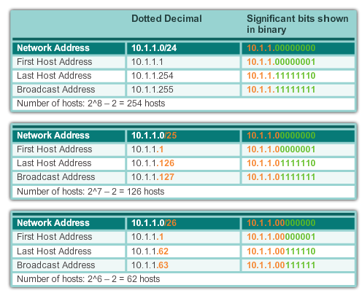
IPv4 Subnet Mask
Examining the Prefix Length
Notes:
8.1.2.2 Examining the Prefix Length

Slide 16
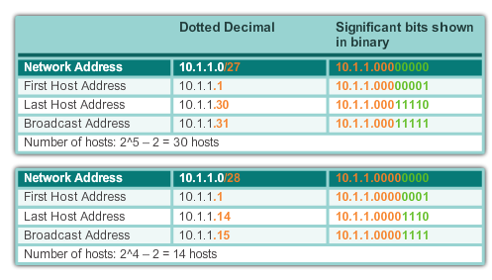
IPv4 Subnet Mask
Examining the Prefix Length (cont.)
Notes:
8.1.2.2 Examining the Prefix Length (cont.)

Slide 17
IPv4 Subnet Mask
Examining the Prefix Length (cont.)
Network address is the first address of a network/subnet:-
  Host bits are all 0
  This address is an identity address for the subnet
  CANNOT be assigned to network interfaces
Broadcast address is the last address of a network/subnet:-
  Host bits are all 1
  This address is used to send data to all hosts
  CANNOT be assigned to network interfaces
First to Last host address:-
  The usable range which can be assigned to network interfaces
Observation:-
Subnet mask / prefix determines the size of the subnet:
  the bigger the prefix number, the small the subnet
To find the size of the subnet:-
  Number of usable hosts = 2^(number of host bits) - 2
Notes:
8.1.2.2 Examining the Prefix Length (cont.)

Slide 18
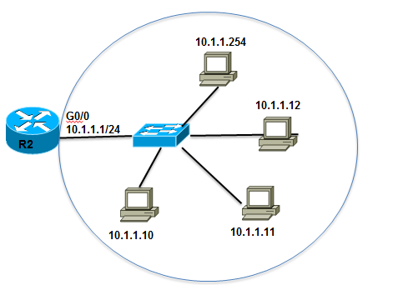
IPv4 Subnet Mask
IPv4 Network, Host, and Broadcast Address
10.1.1.0/24
Network Portion |  |  | Host portion | Type of Address
10 | 1 | 1 | 0
00001010 | 00000001 | 00000001 | 00000000 | All 0s -> Network Address
10 | 1 | 1 | 10
00001010 | 00000001 | 00000001 | 00001010 | 0s and 1s in host portion -> Host Address
10 | 1 | 1 | 255
00001010 | 00000001 | 00000001 | 11111111 | All 1s -> Broadcast Address
Notes:
8.1.2.3 IPv4 Network, Host and Broadcast Address

Slide 19
IPv4 Subnet Mask
IPv4 Network, Host, and Broadcast Address
10.1.1.0/24
Network Portion |  |  | Host portion | Type of Address
10 | 1 | 1 | 1
00001010 | 00000001 | 00000001 | 00000001 | 1st host address
10 | 1 | 1 | 254
00001010 | 00000001 | 00000001 | 11111110 | Last host address
Notes:
8.1.2.3 IPv4 Network, Host and Broadcast Address

Slide 20
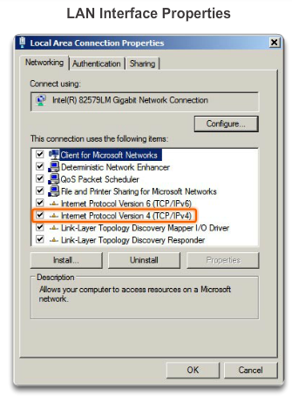
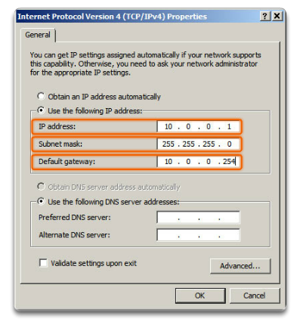
IPv4 Unicast, Broadcast, and Multicast
Assigning a Static IPv4 Address to a Host
LAN Interface Properties
Configuring a Static IPv4 Address
Notes:
8.1.3.1 Assigning a Static IPv4 Address to a Host

Slide 21
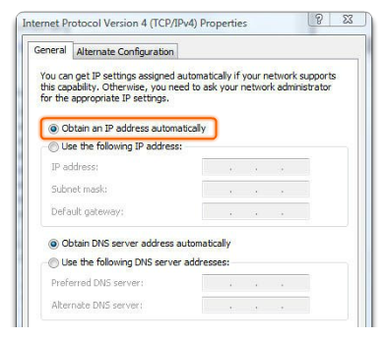
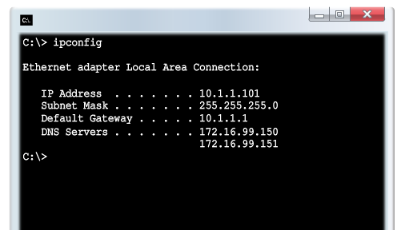
IPv4 Unicast, Broadcast, and Multicast
Assigning a Dynamic IPv4 Address to a Host
Verification
DHCP – The preferred method of assigning IPv4 addresses to hosts on large networks because it reduces the burden on network support staff and virtually eliminates entry errors.
Notes:
8.1.3.2 Assigning a Dynamic IPv4 Address to a Host

Slide 22
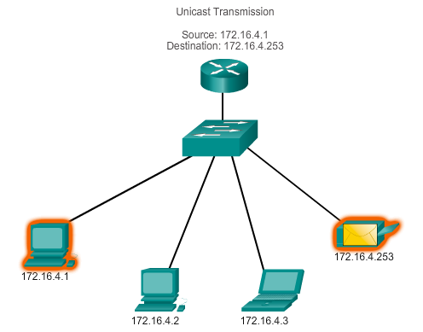
IPv4 Unicast, Broadcast, and Multicast
Unicast Transmission
In an IPv4 network, the hosts can communicate one of three different ways:
Unicast, Broadcast, and Multicast
#1 Unicast – the process of sending a packet from one host to an individual host.
Notes:
8.1.3.3 Unicast Transmission

Slide 23
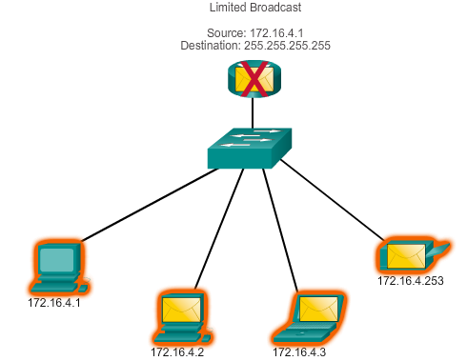
IPv4 Unicast, Broadcast, and Multicast
Broadcast Transmission
In an IPv4 network, the hosts can communicate one of three different ways: Unicast, Broadcast, and Multicast.
#2 Broadcast – the process of sending a packet from one host to all hosts in the network.
Directed broadcast
Destination 172.16.4.255
Hosts within the 172.16.4.0/24 network
NOTE: Routers do not forward a limited broadcast!
Directed broadcast
Destination 172.16.4.255
Hosts within the 172.16.4.0/24 network
Notes:
8.1.3.4 Broadcast Transmission

Slide 24
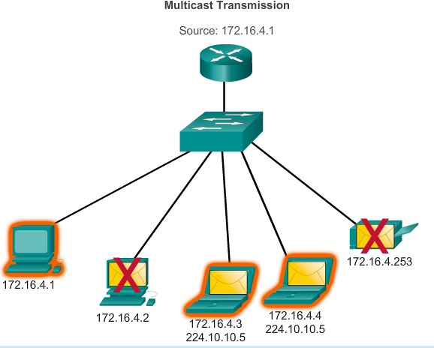
IPv4 Unicast, Broadcast, and Multicast
Multicast Transmission
In an IPv4 network, the hosts can communicate one of three different ways: Unicast, Broadcast, and Multicast.
#3 Multicast – the process of sending a packet from one host to a group of hosts in the network which subscribes to a special range of addresses know as multicast addresses.
In this example, the multicast address is 224.10.10.5
Notes:
8.1.3.4 Broadcast Transmission

Slide 25
Types of IPv4 Address
Public and Private IPv4 Addresses
Private address blocks:
Hosts that do not require direct access to the Internet can use private addresses
  10.0.0.0 to 10.255.255.255 (10.0.0.0/8)
  172.16.0.0 to 172.31.255.255 (172.16.0.0/12)
  192.168.0.0 to 192.168.255.255 (192.168.0.0/16)
Public address blocks:
  Most of the other addresses are publicly accessible from the Internet
  Some address blocks are set aside for special purpose (see next slide)
Notes:
8.1.4.1 Public and Private IPv4 Addresses

Slide 26
Types of IPv4 Address
Special Use IPv4 Addresses
Network and Broadcast addresses – within each network the first and last addresses cannot be assigned to hosts
Loopback address – 127.0.0.1 a special address that hosts use to direct traffic to themselves (addresses 127.0.0.0 to 127.255.255.255 are reserved)
Link-Local address – 169.254.0.0 to 169.254.255.255 (169.254.0.0/16) addresses can be automatically assigned to the local host
TEST-NET addresses – 192.0.2.0 to 192.0.2.255 (192.0.2.0/24) set aside for teaching and learning purposes, used in documentation and network examples
Experimental addresses – 240.0.0.0 to 255.255.255.254 are listed as reserved
Notes:
8.1.4.3 Special Use IPv4 Addresses

Slide 27
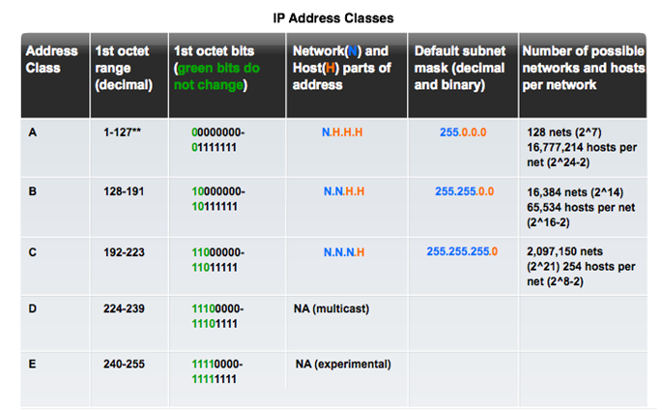
Types of IPv4 Address
Legacy Classful Addressing
Notes:
8.1.4.4 Legacy Classful Addressing

Slide 28
Types of IPv4 Address
Legacy Classful Addressing (cont.)
Problems of legacy classful addressing:-
There are not more than 128 Class A blocks, 16,384 Class B blocks and 2,097,150 Class C blocks
Insufficient for modern world
A company that needs 260 addresses will be assigned a Class B block which leads to wastage of many addresses
Classless Addressing
Formal name is Classless Inter-Domain Routing (CIDR, pronounced “cider
Created a new set of standards that allowed service providers to allocate IPv4 addresses on any address bit boundary (prefix length) instead of only by a class A, B, or C address
Notes:
8.1.4.4 Legacy Classful Addressing (cont.)

Slide 29
IP Addressing
Summary
IP addresses are hierarchical with network, subnetwork, and host portions.
An IP address can represent a complete network, a host, or the broadcast address of the network.
The subnet mask or prefix is used to determine the network portion of an IP address.
DHCP enables the automatic assignment of addressing information such as IP address, subnet mask, default gateway, and other configuration information.
IPv4 hosts can communicate one of three different ways: unicast, broadcast, and multicast.
The private IPv4 address blocks are: 10.0.0.0/8, 172.16.0.0/12, and 192.168.0.0/16.
Notes:
Summary

Slide 30
Lec 1: IPv6 Addressing
Introduction to Networks
Notes:
Cisco Networking Academy program
Introduction to Networks
Chapter 8: IP Addressing

Slide 31
Lecture 9: Objectives
  ** Chapter 8 in CCNA R&S: Introduction to Networks 1
Upon completion of this lecture, you will be able to:
Explain the need for IPv6 addressing.
Describe the representation of an IPv6 address.
Describe types of IPv6 network addresses.
Configure global unicast addresses.
Notes:
Chapter 8 Objectives

Slide 32
9.1 IPv6 Network Addresses
Notes:
8.2 IPv6 Network Addresses

Slide 33
IPv4 Issues
The Need for IPv6
IPv6 is designed to be the successor to IPv4.
Depletion of IPv4 address space has been the motivating factor for moving to IPv6.
Projections show that all five RIRs (Regional Internet Registry) will run out of IPv4 addresses between 2015 and 2020.
With an increasing Internet population, a limited IPv4 address space, issues with NAT (Network Address Translation) and an Internet of things, the time has come to begin the transition to IPv6!
IPv4 has a theoretical maximum of 4.3 billion addresses, plus private addresses in combination with NAT.
IPv6 larger 128-bit address space provides for 340 undecillion addresses.
Notes:
8.2.1.1 The Need for IPv6

Slide 34
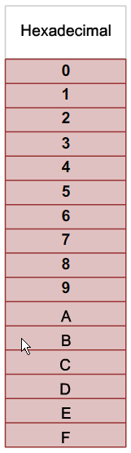
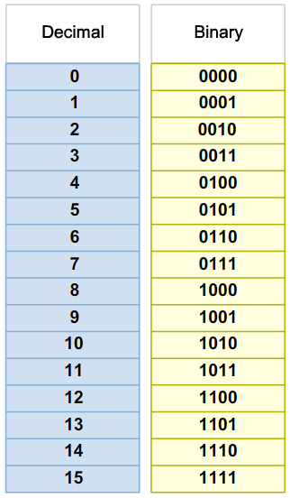
IPv6 Addressing
Hexadecimal Number System
Hexadecimal is a base sixteen system.
Base 16 numbering system uses the numbers 0 to 9 and the letters A to F.
Four bits (half of a byte) can be represented with a single hexadecimal value.
Notes:
8.2.2.1 Hexadecimal Number System

Slide 35
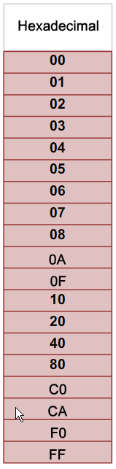
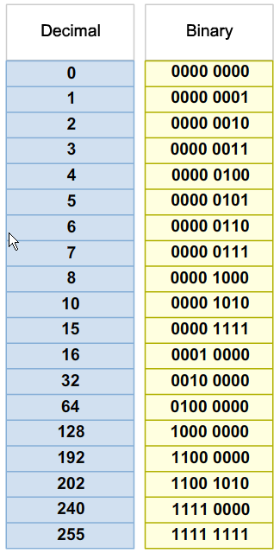
IPv6 Addressing
Hexadecimal Number System (cont.)
Look at the binary bit patterns that match the decimal and hexadecimal values
Notes:
8.2.2.1 Hexadecimal Number System (cont.)

Slide 36
IPv6 Addressing
IPv6 Address Representation
128 bits long and written as a string of hexadecimal digits
Each hexadecimal digit represents 4 bits
Therefore there are 32 hexadecimal digits in total. Example:-
  2001:0DB8:0000:1111:0000:0000:0000:0200
  FE80:0000:0000:0000:0123:4567:89AB:CDEF
An IPv6 address has 8 hextets separated by “:”
Each hextet is 16 bits long or 4 hexadecimal digits
Hex digits are case insensitive
a hextet
This hextet in binary 0010 0000 0000 0001
Notes:
8.2.2.2 IPv6 Address Representation

Slide 37

Compressing an IPv6 Addressing
Rule 1- Omitting Leading 0s
Leading 0s (zeros) in a hextet can be omitted Example:-
  01AB can be represented as 1AB
  09F0 can be represented as 9F0
  0A00 can be represented as A00
  00AB can be represented as AB
  0000 can be represented as 0
Notes:
8.2.2.3 Rule 1 – Omitting Leading 0s

Slide 38
Compressing an IPv6 Addressing
Rule 2 - Omitting Segments with All-0s
Can only be used ONCE
A double colon (::) can replace any continuous string of 0s across one or more hextets
Known as the compressed format.
Example:-
Preferred 2001:0000:000A:1000:0000:0000:0000:0100
Compressed 2001::A:1000:0:0:0:100
Or Compressed 2001:0:A:1000::100
Incorrect compressed format: 2001::A:1000::100
(cannot use “::” more than once)
Notes:
8.2.2.4 Rule 2 – Omitting All 0 Segments

Slide 39
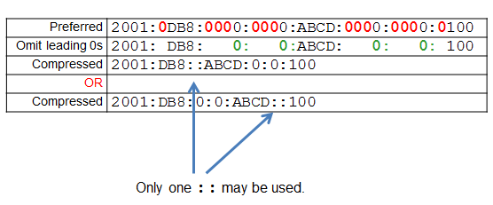
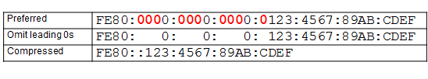
Compressing an IPv6 Addressing
Rule 2 – More examples
Example #1
Example #2
Notes:
8.2.2.4 Rule 2 – Omitting All 0 Segments (cont.)

Slide 40
Compressing an IPv6 Addressing
What is the Compressed format for these IPv6 addresses:-
Preferred 2012:ABCD:EF01:2345:0678:0910:AAAA:BBBB
Compressed
Preferred 1129:0000:2233:4455:6677:0000:0000:0100
Compressed
2012:ABCD:EF01:2345: 678: 910:AAAA:BBBB
1129:0:2233:4455:6677::100
Or
1129::2233:4455:6677:0:0:100

Slide 41
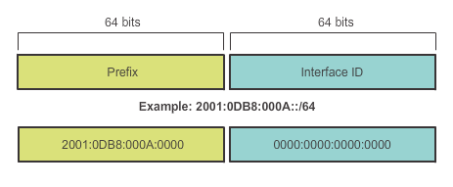
Types of IPv6 Addresses
IPv6 Prefix Length
IPv6 does not use the dotted-decimal subnet mask notation
Prefix length indicates the network portion of an IPv6 address using the following format:
  IPv6 address / prefix length
  Prefix length can range from 0 to 128
  Typical prefix length is /64 for LAN
  Eg: 2001:0DB8:000A::/64
Notes:
8.2.3.2 IPv6 Prefix Length

Slide 42
Types of IPv6 Addresses
IPv6 Address Types
IPv6 has 3 types of addresses:
Unicast: An IPv6 unicast address uniquely identifies an interface on an IPv6-enabled device.
Multicast: An IPv6 multicast address is used to send a single IPv6 packet to multiple destinations.
Anycast: An IPv6 anycast address is a unicast address assigned to multiple devices. A packet sent to an anycast address is routed to the nearest device having that address.
Note: IPv6 does not have broadcast addresses.
Notes:
8.2.3.1 IPv6 Address Types

Slide 43
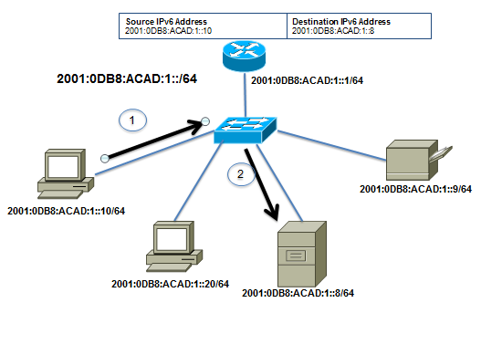
Types of IPv6 Addresses
IPv6 Unicast Addresses
Unicast
  Uniquely identifies an interface on a IPv6-enabled device
  A packet sent to a unicast address is received by the interface that is assigned that address.
Notes:
8.2.3.1/8.2.3.3 IPv6 Unicast Addresses

Slide 44
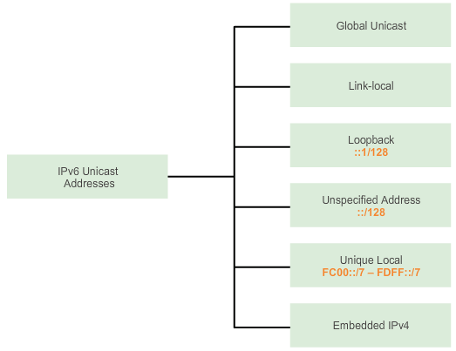
Types of IPv6 Addresses
IPv6 Unicast Addresses (cont.)
There are 6 types of IPv6 unicast addresses
Notes:
8.2.3.3 IPv6 Unicast Addresses (cont.)

Slide 45

Types of IPv6 Addresses
IPv6 Unicast Addresses (cont.)
1. Global Unicast
  Similar to a public IPv4 address
  Globally unique
  Internet routable addresses
  Can be configured statically or dynamically
2. Link-local
  Used to communicate with other devices on the same subnet
  Not routable beyond the subnet
Notes:
8.2.3.3 IPv6 Unicast Addresses (cont.)

Slide 46
Types of IPv6 Addresses
IPv6 Unicast Addresses (cont.)
3. Loopback (::1/128)
  Used by a host to send a packet to itself
  Cannot be assigned to a physical interface
  All-0s except for the last bit
4. Unspecified Address (::/128)
  All-0’s address
  Cannot be assigned to an interface
  Used as a source address when the device does not yet have a permanent IPv6 address or when the source of the packet is irrelevant to the destination.
Notes:
8.2.3.3 IPv6 Unicast Addresses (cont.)

Slide 47
Types of IPv6 Addresses
IPv6 Unicast Addresses (cont.)
5. Unique Local
  Similar to private addresses for IPv4
  Used for local addressing within a site or between
  a limited number of sites.
  In the range of FC00::/7 to FDFF::/7
6. IPv4 Embedded (not covered in this course)
  Used to help transition from IPv4 to IPv6.
Notes:
8.2.3.3 IPv6 Unicast Addresses (cont.)

Slide 48
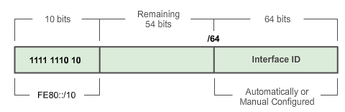
Types of IPv6 Addresses
IPv6 Link-Local Unicast Address
IPv6-enabled network interfaces can have more than 1 address.
  A link-local address is a MANDATORY address and is automatically configured on all IPv6 enabled interfaces
It is used to communicate with other IPv6 devices in that subnet
The address is: FE80::X/10 (first 10 bits are 1111 1110 1000)
Notes:
8.2.3.4 IPv6 Link-Local Unicast Addresses

Slide 49
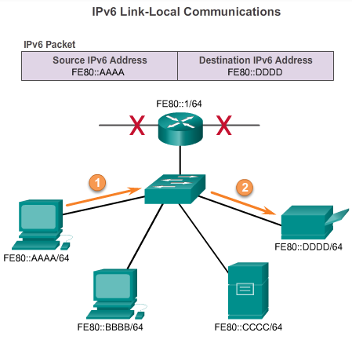
Types of IPv6 Addresses
IPv6 Link-Local Unicast Address (cont.)
Note:
1. Packets with source or destination link-local address cannot be routed beyond the link from where the packet originated.
  => routers do not forward packets containing link-local addresses.
Notes:
8.2.3.4 IPv6 Link-Local Unicast Addresses

Slide 50
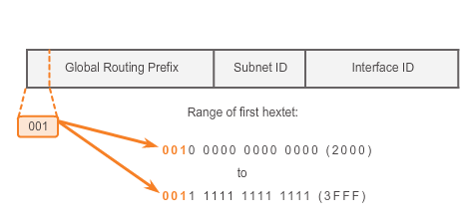
IPv6 Unicast Addresses
IPv6 Global Unicast Address
Currently, only global unicast addresses with the first three bits of 001 ( 2000::/3) have being assigned
Notes:
8.2.4.1 Structure of an IPv6 Global Unicast Address (cont.)

Slide 51
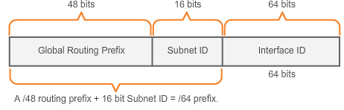
IPv6 Unicast Addresses
IPv6 Global Unicast Address (cont.)
A global unicast address has three parts: Global Routing Prefix, Subnet ID, and Interface ID.
Global Routing Prefix is the prefix or network portion of the address assigned by the provider (like ISP) to a customer or site
Currently, RIRs assign a /48 global routing prefix to customers
2001:0DB8:ACAD::/48 has a prefix that indicates that the first 48 bits (2001:0DB8:ACAD) is the network portion.
Notes:
8.2.4.1 Structure of an IPv6 Global Unicast Address (cont.)

Slide 52
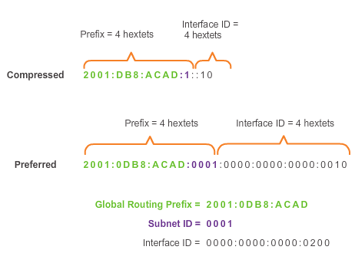
IPv6 Unicast Addresses
IPv6 Global Unicast Address (cont.)
Subnet ID is used by a site to identify subnets within
Interface ID
  Equivalent to the host portion of an IPv4 address.
  Used because a single host may have multiple interfaces, each having one or more IPv6 addresses.
Notes:
8.2.4.1 Structure of an IPv6 Global Unicast Address

Slide 53
IPv6 Unicast Addresses
The Interface ID
The 64-bit Interface ID can be assigned using:-
1. EUI-64 (Extended Unique Identifier)
  Uses the MAC address (48-bit) by inserting another 16 bits in the middle to create a 64-bit Interface ID
  The 7th bit (aka. Universally/Locally bit) is reversed (0->1 or 1->0)
  FFFE is inserted after the 24th bit
2. Randomly Generated
  Windows (Vista onwards) uses a randomly generated Interface ID instead of one created with EUI-64
  Windows XP (and earlier) used EUI-64
Notes:
8.2.4.5 EUI-64 Process or Randomly Generated

Slide 54
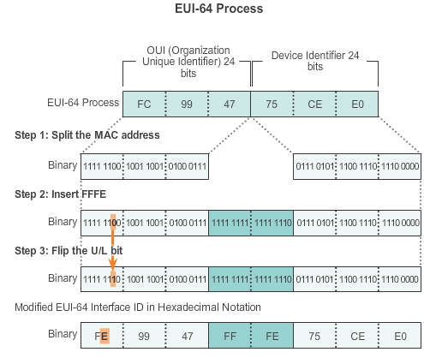
IPv6 Unicast Addresses
The Interface ID
Notes:
8.2.4.5 EUI-64 Process or Randomly Generated

Slide 55
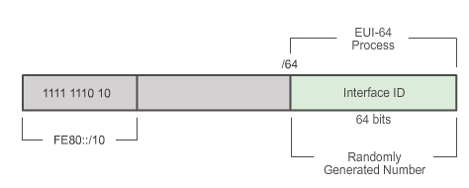
IPv6 Unicast Addresses
IPv6 Enabled End Device
When the network interface of a device is enabled and connected:-
it automatically generates a link-local IPv6 address: FE80::X (where X is the Interface ID)
For the global unicast address, it can be set either :-
  Statically by the user (does not scale well in large sites)
  Dynamically through network services (SLAAC, DHCPv6)
Notes:
8.2.4.6 Dynamic Link-local Addresses

Slide 56
Summary
Each IPv6 address has 128 bits verses the 32 bits in an IPv4 address.
The prefix length is used to indicate the network portion of an IPv6 address using the following format: IPv6 address/prefix length.
There are three types of IPv6 addresses: unicast, multicast and anycast.
An IPv6 link-local address enables a device to communicate with other IPv6-enabled devices on the same link and only on that link (subnet).
Packets with a source or destination link-local address cannot be routed beyond the link from where the packet originated.
IPv6 link-local addresses are in the FE80::/10 range.
IPv6 global unicast addresses currently assigned are 2000::/3
Notes:
Summary

